Slide 1
Reasonable Accommodations in the Workplace
Erissa Duvall - https://linktr.ee/corgidev

Slide 2
Warning
I may allude to some topics of discrimination, bullying, domestic violence, child abuse, and trauma.
However, I will do my best to keep these to a minimum to hopefully avoid harming anyone.
I am keenly aware of how sensitive these topics can be.

Slide 3
Disclaimer
While I may mention some examples from current/past jobs, I am not speaking for my employers.
Additionally, I am not a lawyer and nothing I say should be taken as definitive legal advice.

Slide 4
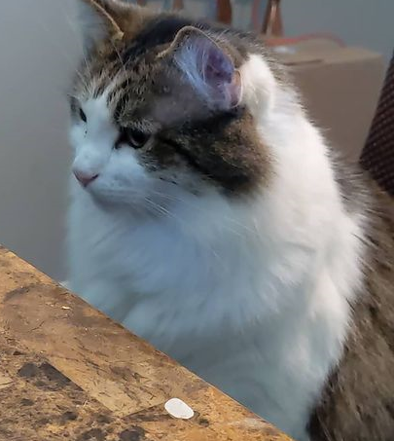
Overview
What is disability?
My Persona
Tips for RA Requestors
Tips for RA Professionals
Benefits of an Inclusive RA Policy & Accessible Workplace
Resources
QA
Notes:
Image source: Erissa Duvall’s cat Nibbler

Slide 5
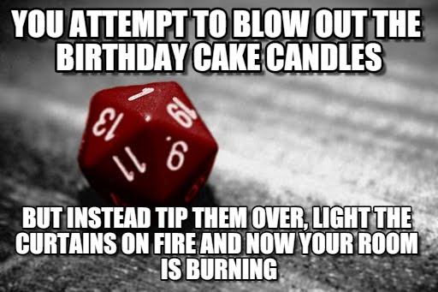
What is a disability?
Definitions
ADA
Social Model
Disabilities can affect people in different ways:
What part of their life does it affect?
Ability to eat
Ability to breathe
Ability to walk, stand, or lift
Ability to interpret information
Ability to see or hear
Ability to care for themselves
Visibility of the disability
When does it affect them? (temporary, permanent, situational)
Notes:
Image sourced from Critical Successes and Critical Failures from 1 to 20 in D&D – Nerdarchy
Image Source URL: https://nerdarchy.com/critical-successes-and-critical-failures-from-1-to-20-in-dd/

Slide 6
Important Note
Just because 2 people have the same disability label DOES NOT mean they will present exactly the same way or encounter the same barriers.

Slide 7
Do I “look” like I have a disability?

Slide 8

My Persona
I am a soon to be 38-year-old Accessibility Engineer.
My job duties require that I:
work at a computer for most, if not the entire, work day
organize large amounts of information
follow instructions to analyze content and derive conclusions
Impact of Disabilities:
difficulty standing in place for extended periods
difficulty lifting, carrying items for a distance
difficulty going upstairs
difficulty maintaining focus
easily distracted by background noises and activity
limited working memory
difficulty context switching
hard of hearing
Notes:
Image sourced from Critical Successes and Critical Failures from 1 to 20 in D&D – Nerdarchy
Image Source URL: https://nerdarchy.com/critical-successes-and-critical-failures-from-1-to-20-in-dd/

Slide 9
My Persona Continued
I benefit from:
Flexible start / stop times
Flexible work location (WFH)
Flexible deadlines for work
Clearly defined tasks / scope
Limited context switching
Minimal interruptions
Ability to take occasional breaks when overwhelmed
Clearly documented processes or ability to ask questions as needed
Notes:
Image sourced from Critical Successes and Critical Failures from 1 to 20 in D&D – Nerdarchy
Image Source URL: https://nerdarchy.com/critical-successes-and-critical-failures-from-1-to-20-in-dd/

Slide 10
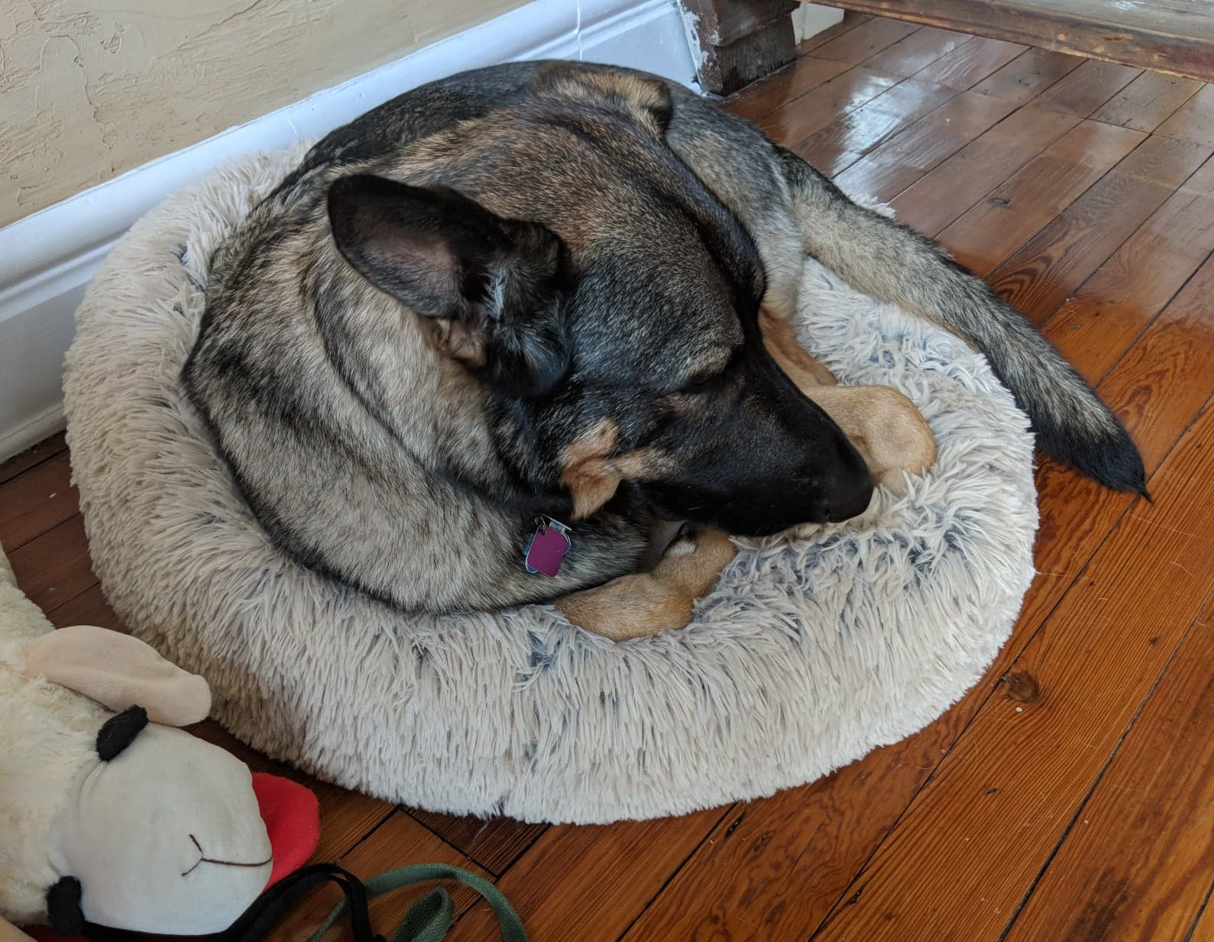
Tips for RA Requestors
Find a primary physician and build a rapport with them.
If you can, try to get a formal diagnosis and/or accommodation note from a physician.
Identify a variety of options.
Be open to compromise.
Identify if your company has a formal procedure.
Remember that not all companies are required to follow ADA regulations, even if they really should.
Notes:
Finding a primary physician
- May be able to go ahead and write an accommodation note for some basic accommodations to add some validity to your claim in the eyes of whomever is going to have to approve it.
- Could give you breathing room until you can meet a specialist
- Might be able to help you better identify the right doctor you need to see for an accommodation.

Slide 11
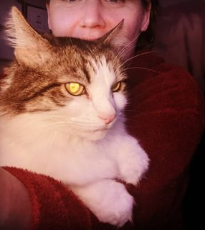
Tips for RA Professionals
View disability through the social model
Require no/minimal medical information from requestor
Minimize how much info is provided to involved parties
Build Accessibility personas with suggested recommendations to help give you a starting point.
Gain a general understanding of how some assistive technologies (hardware/software) benefit users.
Involve IT and facilities management departments in the discussions since some accommodations could involve these groups.
Have a clearly documented process that includes employees, contractors, applicants, and interviewees.
Make sure the documentation and overall process is accessible to all the aforementioned individuals.
Notes:
Social Model Definition of Disability:
Developed by disability rights activities in the 1970s and 80s.
“…views the origins of disability as the mental attitudes and physical structures of society, rather than a medical condition faced by an individual.” – Social Creatures
Source URL: https://www.thesocialcreatures.org/thecreaturetimes/the-social-model-of-disability
The social model essentially says that it is society and the environment in which a person is in that creates barriers for someone when living their daily life more so than a medical condition.
There can be many barriers to anything medical related can involve:
Cost
Unconscious, and often deeply ingrained, bias
Some procedures are not as well covered, if at all, by insurance regardless of how good the insurance is.
Minimize how much info is provided to involved parties:
Minimizes unconscious bias that may slip in when people know who specifically a user is.
Lessens risk of a HIPPA violation or leaking private information a person may not want everyone knowing.
Example) The RA department has an employee named is John Doe, he is 32, works as a lead developer, and has vision loss due to a traumatic injury.
Since sight loss tends to be a more apparent disability, they may require no medical documentation. However, they may need such details for, for leave or insurance reasons.
When RA coordinates with IT to find a solution to help John, they would provide the absolute minimum details necessary for IT to identify a solution.
So they may just tell them that they have a developer, who is having trouble using his computer due to sight loss.
They might go into more details on exact job duties, applications used, hardware used. Especially since this could help them ID if they already have a solution available.
If the user needs to be added to a security group they would then need to share the users ID and/or name. However, beyond that, they would avoid sharing any personal details about the user.

Slide 12
Tips for RA Professionals Continued
Have an accessibility procurement policy for all software and hardware used by the company.
Have general Accessibility policies to help make your products, facilities, and more accessible from the ground up.

Slide 13
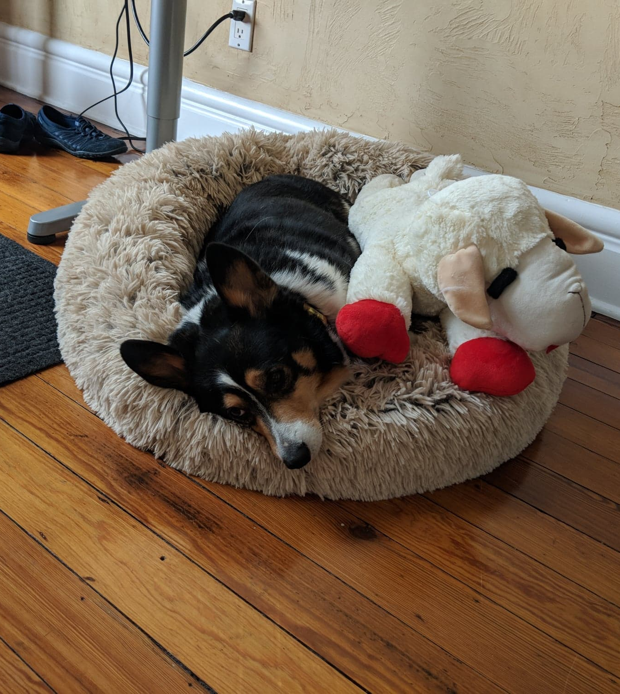
Benefits of an Inclusive RA Policy and Accessible Workplace
Positive image to all within and around
Builds a welcoming environment
Encourages productivity
Encourages diversity
Encourages innovation

Slide 14
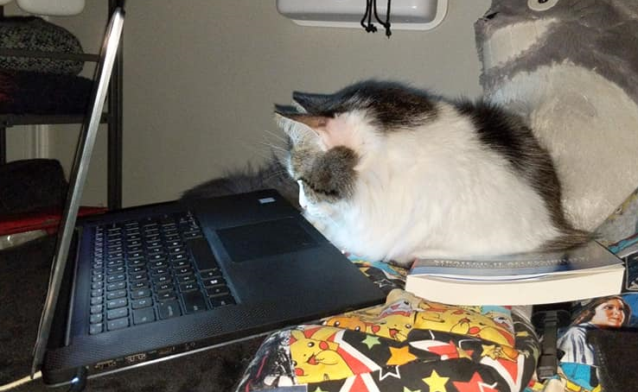
RA Resources
Government RA Documentation
Types of Reasonable Accommodation | Office of Disability Rights (ODR)
When Can the District Deny an Accommodation? | Office of Disability Rights (ODR)
Enforcement Guidance on Reasonable Accommodation and Undue Hardship under the ADA | U.S. Equal Employment Opportunity Commission (EEOC)
Accommodations | U.S. Department of Labor (DOL)
The Americans with Disabilities Act | ADA

Slide 15
RA Resources Continued
Accessibility Personas
Creating accessibility personas. | by Alicia Crowther | UX Collective
Personas with Disabilities. Some people love personas. Some people… | by Sheri Byrne-Haber, CPACC | The Startup | Medium
Accessibility Personas | UK Government Digital Service GitHub
Design Personas: Digital Accessibility Recommendations for Interactive Designs | Office of Digital Accessibility | Stanford University
Tips for Creating Accessibility Personas | Bureau of Internet Accessibility

Slide 16
RA Resources Continued
Additional RA Documentation
Employers' Practical Guide to Reasonable Accommodation Under the Americans with Disabilities Act (ADA) - Job Accommodation Network (JAN)
Accommodations and Accessibility | American Foundation for the Blind
What is ADA Compliance | ADA Compliant Business - Advocates for the Life Skills & Opportunity (ALSO)
Americans With Disabilities Act (ADA) Myths And Facts - Paralyzed Veterans of America (PVA)

Slide 17

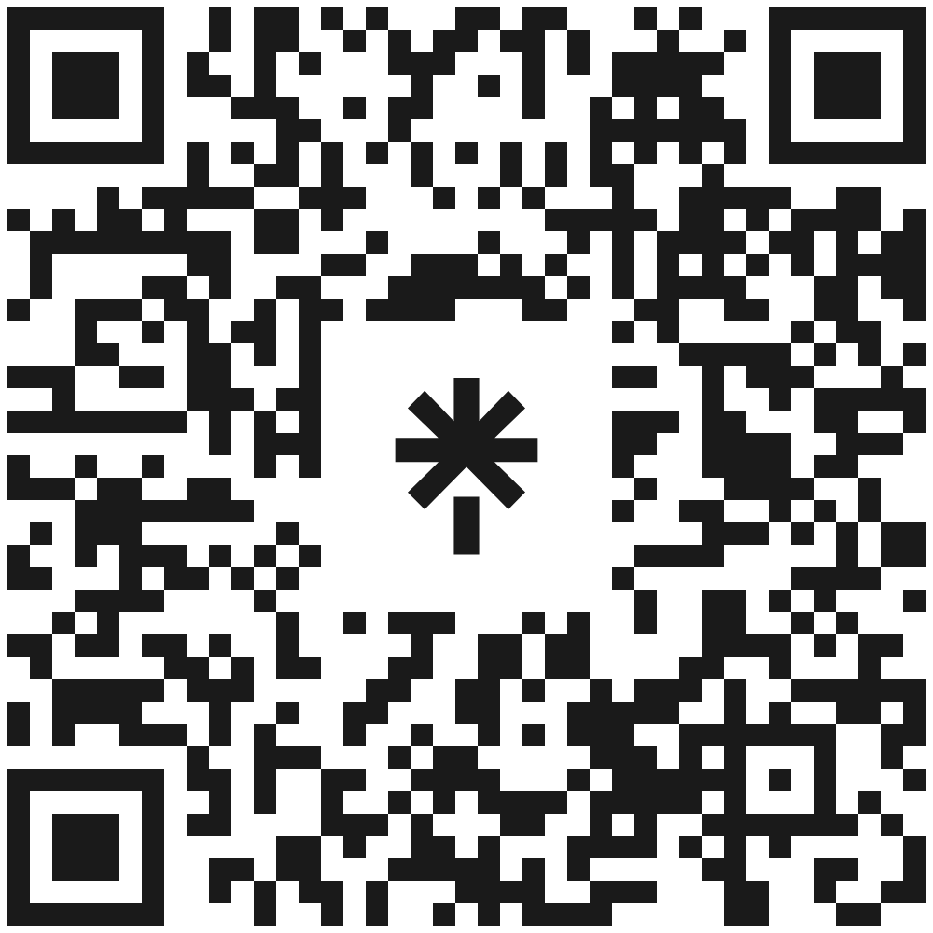
Thank You! Questions & Answers
https://linktr.ee/corgidev

